Slide 1
ENSE 400
Bi-Weekly Scrum Report-Out
[Group name]
[Group members]
[Date of report-out]

Slide 2
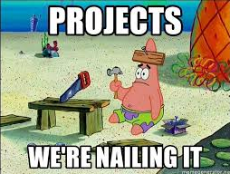
Project deats
Remind me what you are doing
  What problem(s) are you trying to solve?
  What gap are you filling?
  What innovation are you creating and introducing to the world?

Slide 3

Project & documentation review
What are you currently working on?
“Show me what you got” (including but not limited to…)
  Project initiating and planning
    Business case and Charter – the vision and rationale – the problem and the “why"
    Eliciting and documenting the groundwork of design (requirements, scope, scheduling, team, budget, and the like)
    Stakeholders and communications
    Assumptions and risk
    Quality and constraints
    Picturing (software) architecture
  Project execution (see next slide too)
    Coding & debugging
    Testing
      Code
      Usability
    Deployment
GitHub/Version control “stamp of approval”
  Is it readable, usable, does your team confirm its “goodness”?

Slide 4
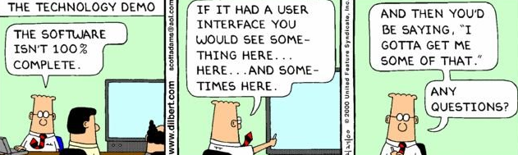
Project demo
If available, demo what you got running
Include lo/hi-fi/real screenshots here as well

Slide 5

Group reflection
Do you feel you are on track?
  [Response here]
Do you feel there are barriers to your success (if any)?
  [Response here – Go beyond “time” or “we’re busy”]
    Time is limited for everyone and everyone is busy
    Such is the life of a SSE’er
Do you need any help going forward?
  [Response here]
Any other questions or concerns?
  [Response here]

Slide 6
Image refs
Show me what you got, https://pictures.abebooks.com/isbn/9781548899530-us-300.jpg
Patrick, https://imgflip.com/memetemplate/43274976/spongebob-patrick-nail-saw
Dilbert, http://4.bp.blogspot.com/-tVbJsudDNaw/T29WxQ0PHZI/AAAAAAAAABc/UlTwD2gkzA4/s1600/Dilbert%2520Software%2520Demo%5B1%5D.jpg
Pondering, https://imgflip.com/s/meme/Question-Rage-Face.jpg

